Slide 1
Noisy to Clean Speech Enhancement
Dataset: WTIMIT
Sampling Rate: 22050 Hz
Epochs: 100

Slide 2

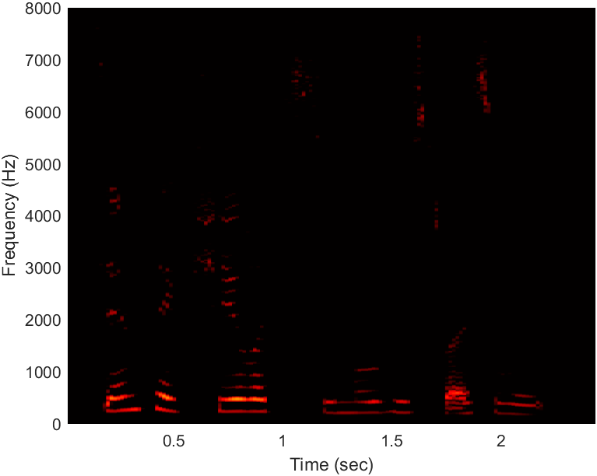
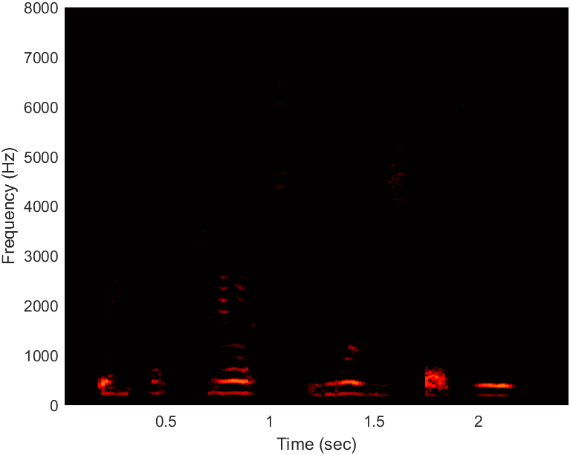
Speaker 1 (sentence: Tim takes Sheila to see movies twice a week.)
Clean audio spectrogram Converted audio spectrogram

Slide 3
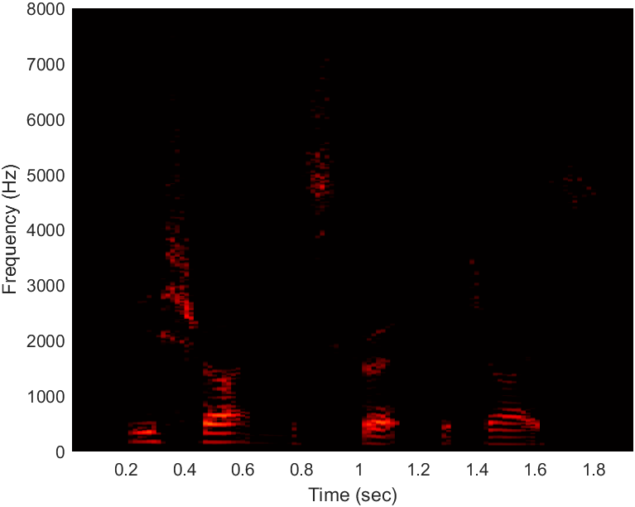
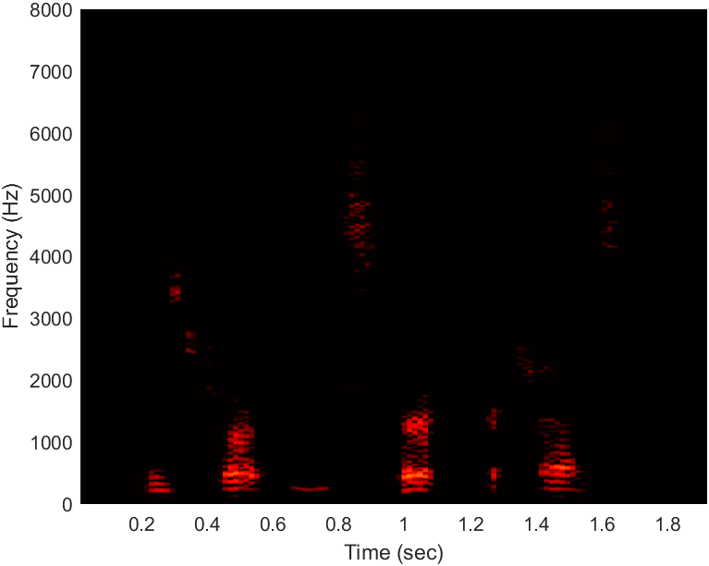
Speaker 2 (sentence: Please shorten this skirt for Joyce)
Clean audio spectrogram Converted audio spectrogram

Slide 4
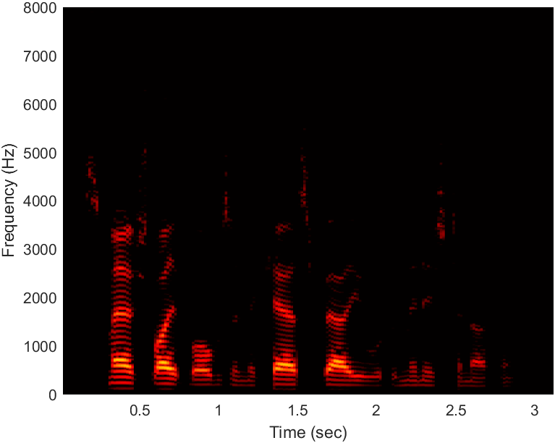
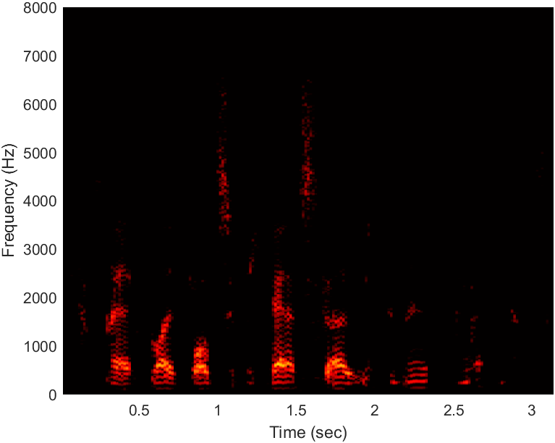
Speaker 3 (sentence: Smash light bulbs and their cash value will diminish to nothing.)
Clean audio spectrogram Converted audio spectrogram

Slide 5
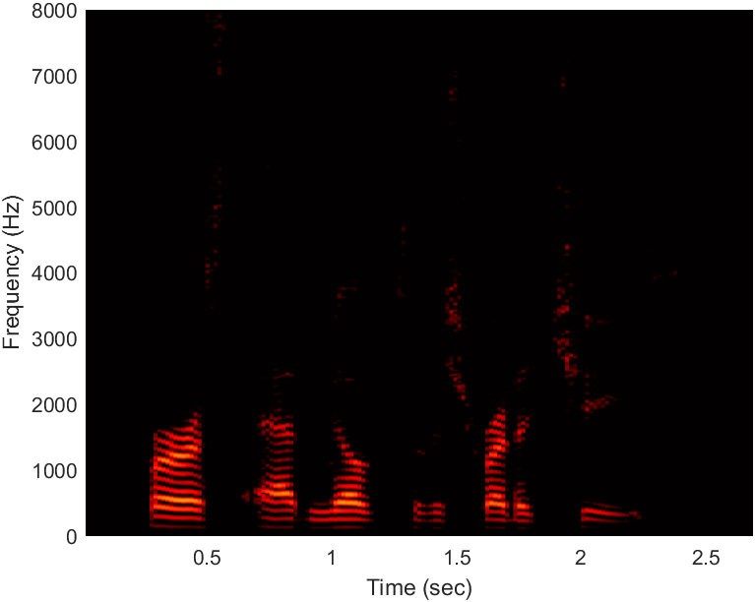
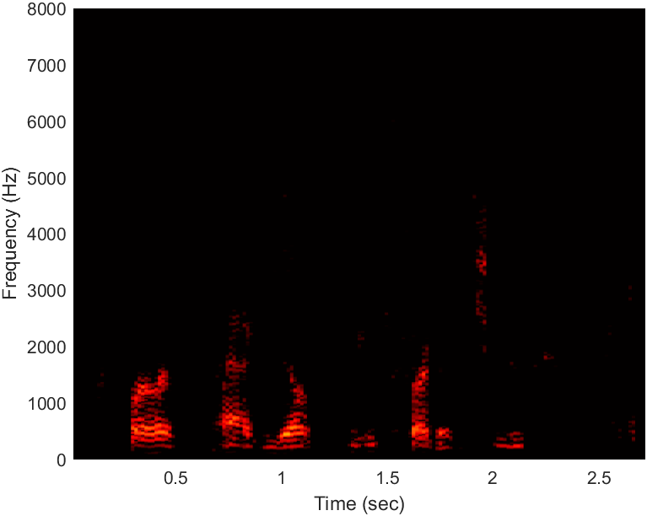
Speaker 4 (sentence: First add milk to the shredded cheese.)
Clean audio spectrogram Converted audio spectrogram

Slide 6
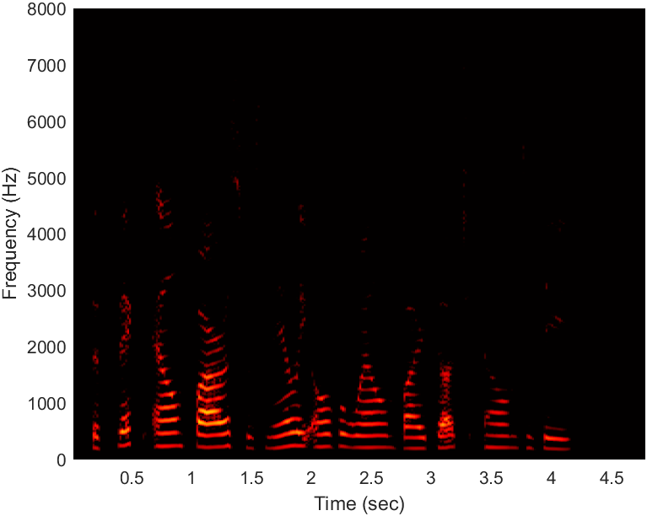
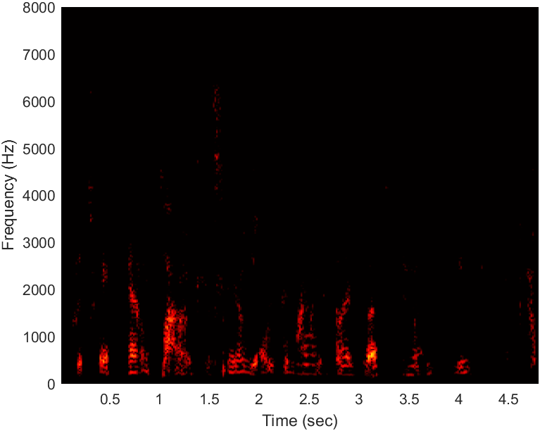
Speaker 5 (sentence: The thick elm forest was nearly overwhelmed by Dutch Elm Disease.)
Clean audio spectrogram Converted audio spectrogram

Slide 7
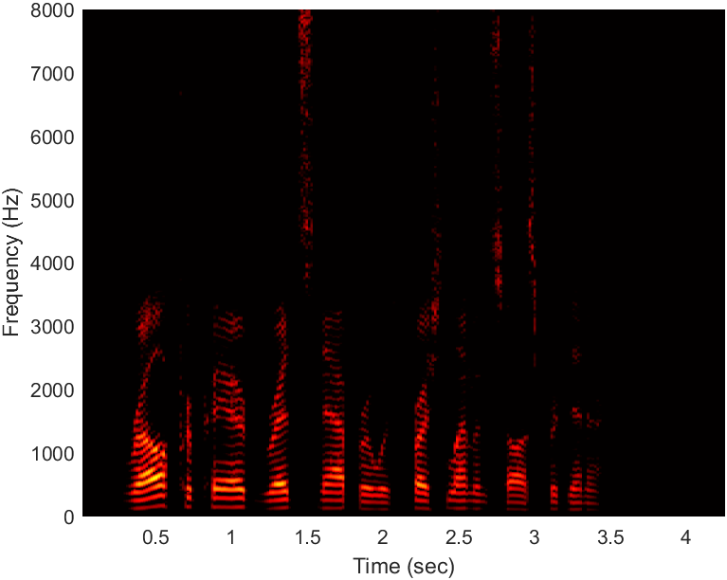

Speaker 6 (sentence: Ralph prepared red snapper with fresh lemon sauce for dinner.)
Clean audio spectrogram Converted audio spectrogram

Slide 8
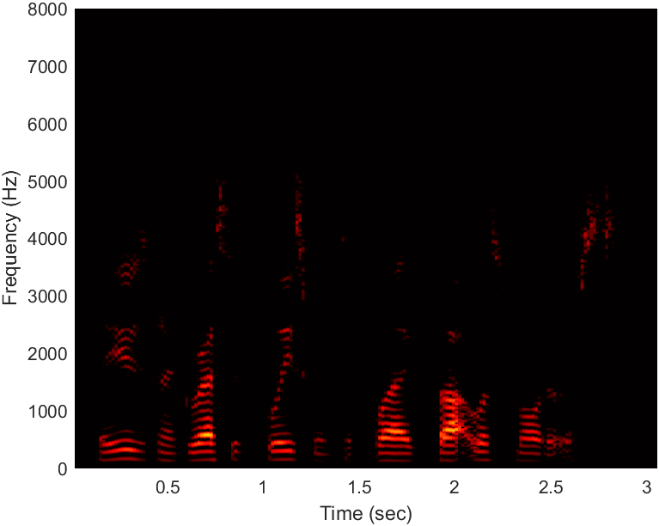
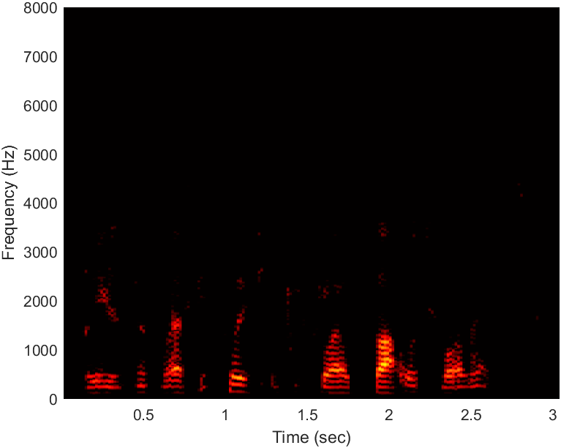
Speaker 7 (speaker: They used an aggressive policeman to flag thoughtless motorists.)
Clean audio spectrogram Converted audio spectrogram

Slide 9
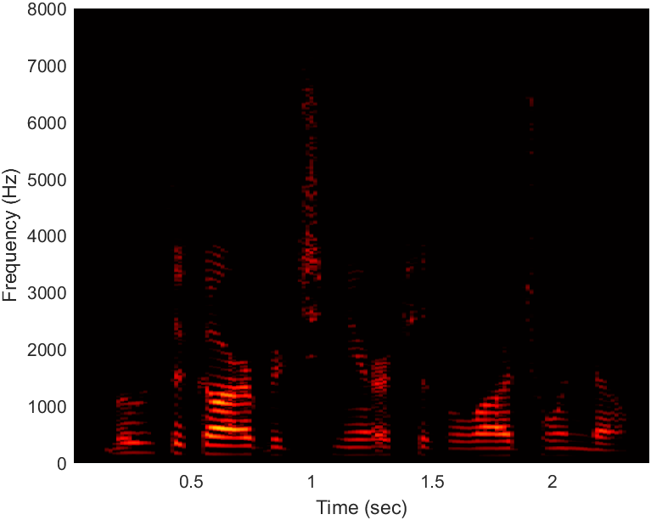
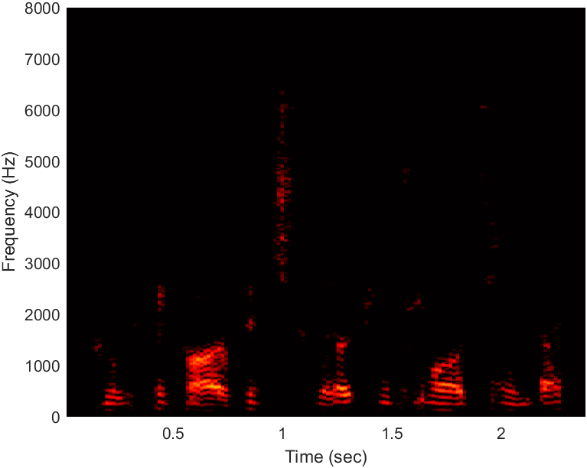
Speaker 8 (sentence: Move the garbage nearer to the large window.)
Clean audio spectrogram Converted audio spectrogram

Slide 10
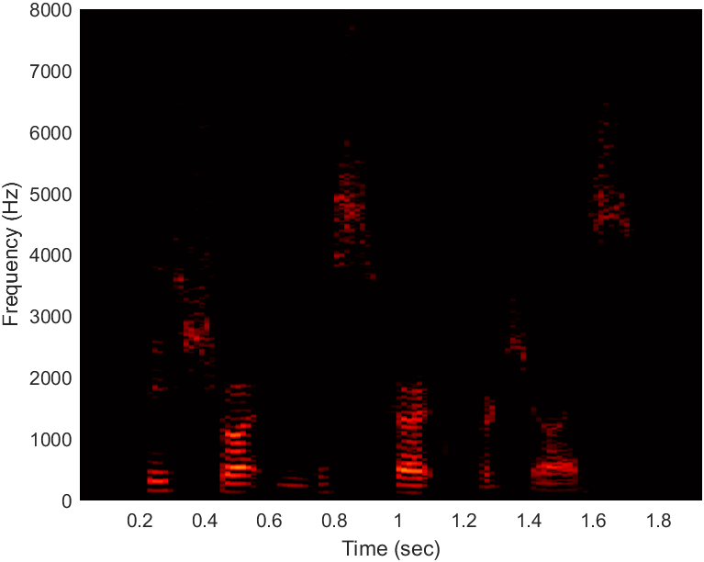
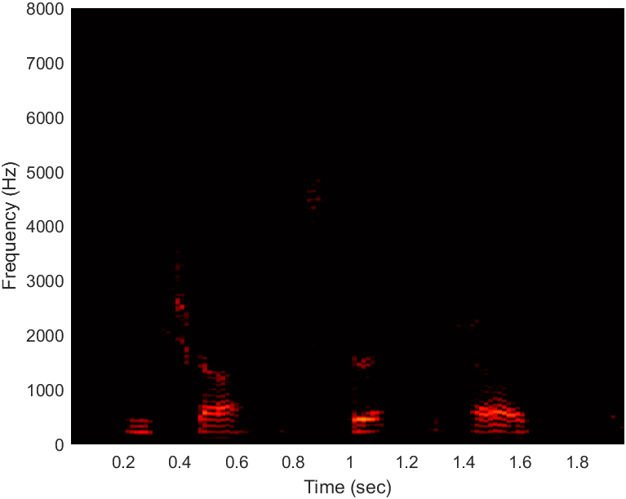
Speaker 9 (sentence: Please shorten this skirt for Joyce)
Clean audio spectrogram Converted audio spectrogram

